Slide 1
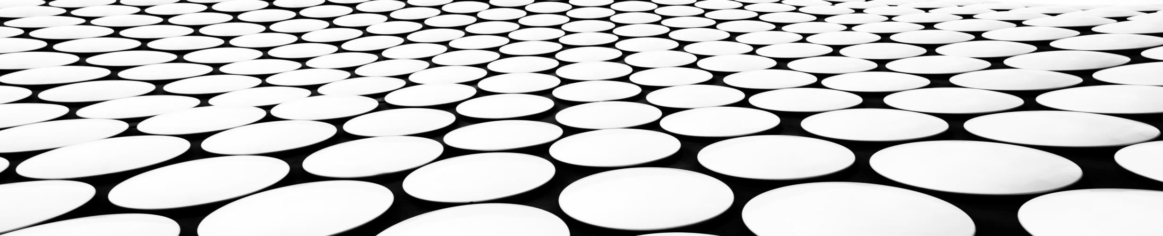
Final presentation
Transformation net: Pose estimation in Nerf
GROUP MEMBER: CHENFENG SHAN, XIANGYU ZENG

Slide 2
Motivation and goal
Motivation:
The original Nerf has many limitations; For instance, it needs to know the pose matrix of the camera where each picture was taken
The research Nerf -- want to integrate the learning of pose information into the nerf training process, making use of the consistency of neural light field. But it is not that reasonable
If we could estimate the transformation of pose matrix, it would be easy to generate static scene from series images or videos.
Goals:
We want to estimate the transformation between two images, so if we get the information of one pose matrix, we could estimate all the pose matrix for other images.

Slide 3
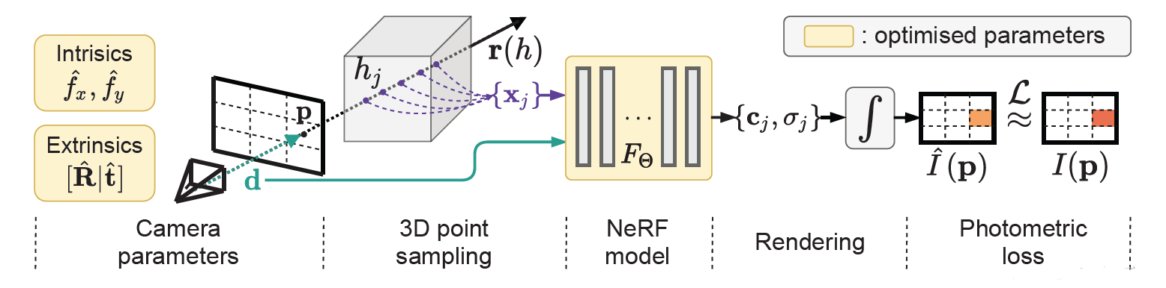
Nerf -- arxiv.org/abs/2102.07064
The training process of nerf--, they use neural network to infer the intrinsic and extrinsic parameters of the camera pose matrix, sampling points from a inferred direction and see the difference between sampling pixel and the pixel in original image. it is not reasonable, as if the direction you infere is totally wrong, it would frequently adjust the direction and regenerate neural radiance field, which is hard to converge
(PS. They use Colmap to solve the cool start problem)
Another limitation of nerf- - is that the learning of pose matrix is bound with the training of nerf, which means it could be lack of generalization (overfitting). It may need to be retrained in new scenes.

Slide 4
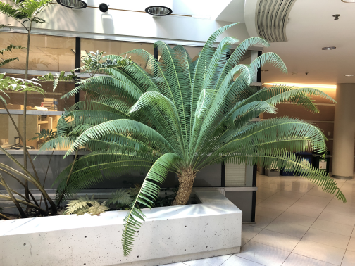
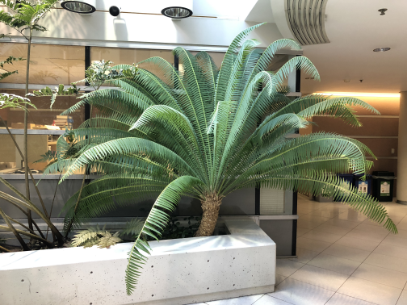
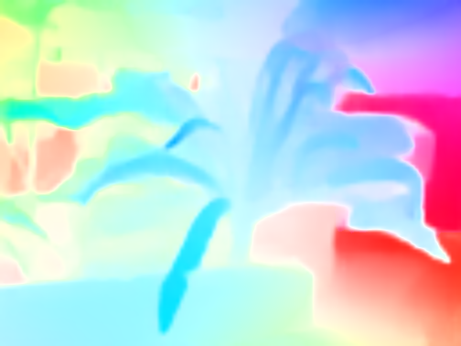
Optic field
optic flow vector: the image motion of a scene point.
optic flow field: the collection of all the optic flow vectors
Given two images we could calculate the optic flow field by mapping all the points from image 1 to image 2.
Good news: There are already a lot of mature technologies in this area, so we could make use of them, the flownet2 was used to generate the optic field for this project

Slide 5
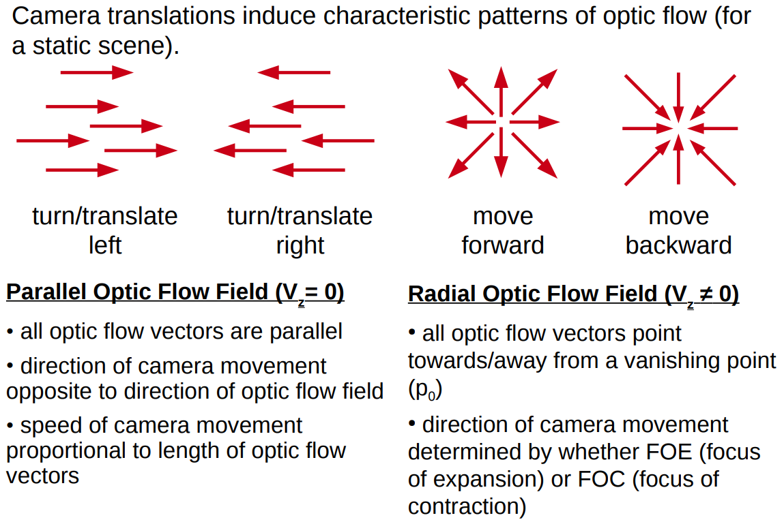
Why optic field

Slide 6
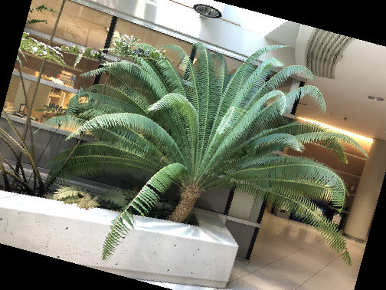


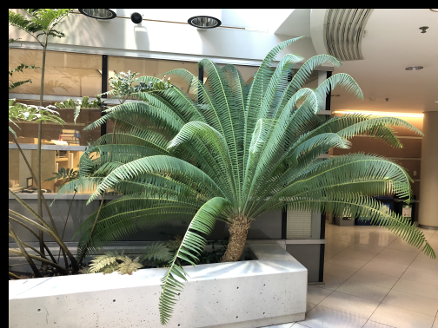

Pattern of optic field

Slide 7
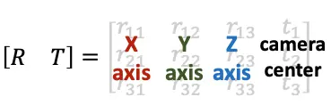
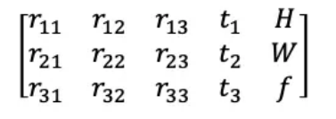
Camera pose matrix
Pose matrix contains the intrinsic and extrinsic information of the camera.
To make it easy to understand, the first three columns of vectors are the x, y, and z axes of the camera direction in the real world coordinate system, and t1, t2, and t3 are the camera positions. The last three parameters (intrinsic) represent the height and width of the image, and the focal length of the lens.
We assume that the extrinsic parameters are known in this project, we’d
like to estimate the transformation of [R T] matrix

Slide 8
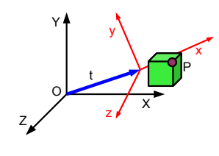
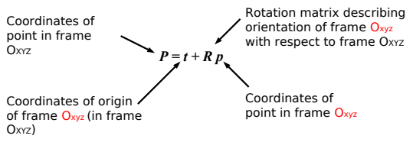
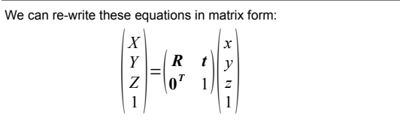
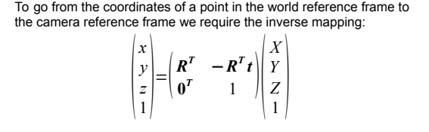
Transformation of camera

Slide 9
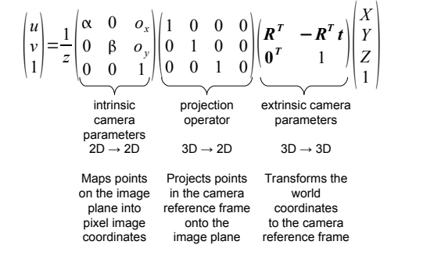
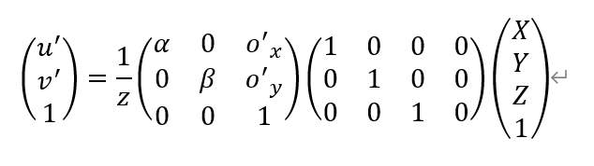
Transformation of camera
If we assume camera 1 is on world coordinate system XYZ, camera 2 is on coordinate system xyz. Then the formula on the left represents the pixels in camera 2 and the formula on the right represents the pixels in camera 1.

Slide 10
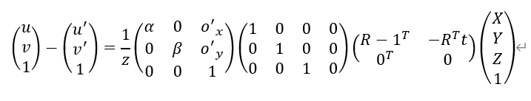
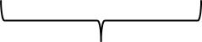
Relation between transformation and optic field
Unknown: Real world
coordinate
Optic field
Known: intrinsic parameter
Estimation target
Then with a simple subtraction, we relate the optic flow field to the transformation matrix, which proves that it is reasonable to learn transformation from optic flow field. As for the real world coordinate, this part could also be estimated from depth-net or learned from the integration of the nerf.

Slide 11
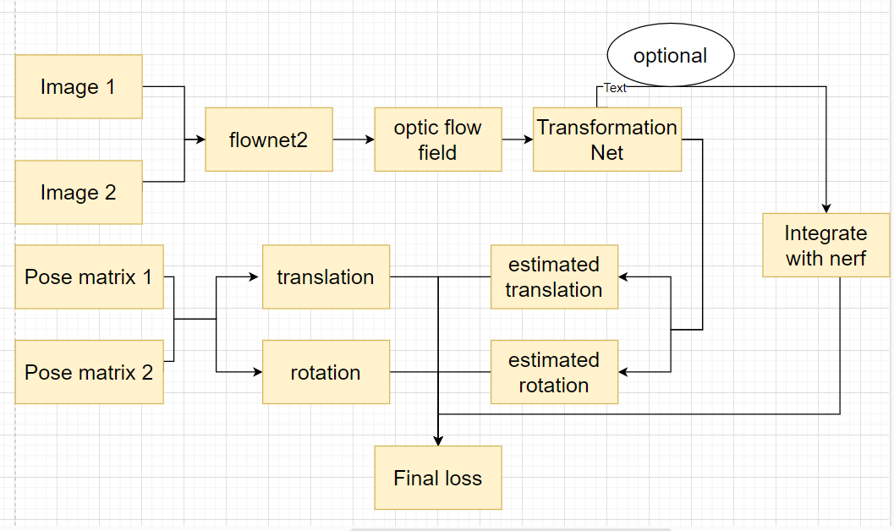
Training process

Slide 12
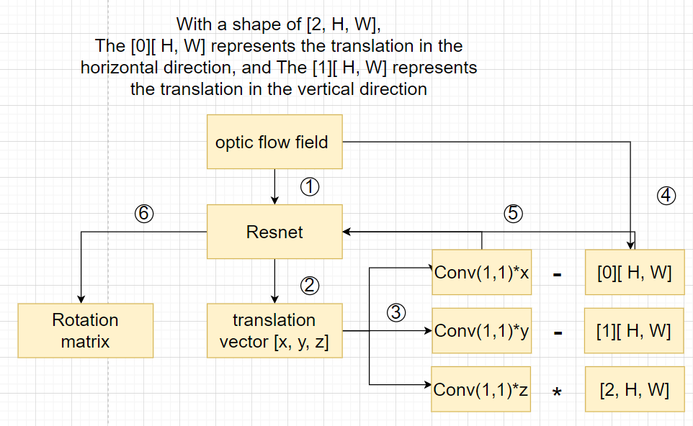
Transformation Net
Remember that we discussed that the translation of camera has simple representation in optic flow field?
We use single convolution layer to learn a weight. And remove the optic flow field generated by translation from original optic flow field.
Then the rest of the optic flow field would be the effect brought by rotation

Slide 13
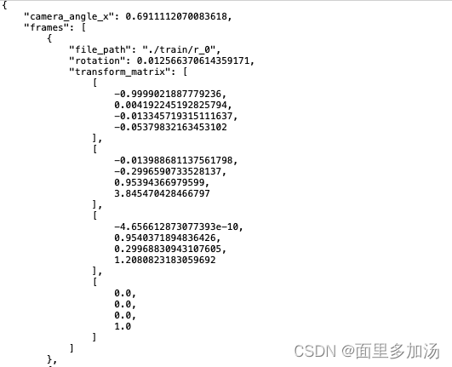
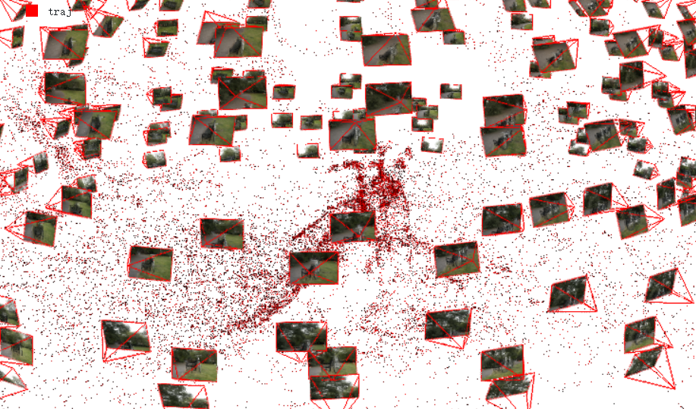
Dataset
LLFF(Layered Learned Feature Fields) format dataset:
Includes the camera information, images, and the pos matrix of each images. Information other than images is stored in json format.
self-made dataset:
It is possible to made a dataset by yourself, even don’t need the camera information. The camera information could be estimated with the help of COLMAP. Some investigations like Nerf - - uses neural network to do the job, so the scene could be restored without the camera information.

Slide 14
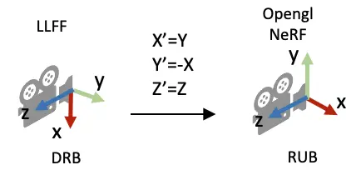
Dataset
To start the training, the target dataset must contains multiple sets of static scene photos and corresponding pose matrix, with only camera moves. Fortunately, most of the data used in Nerf researches meets this requirement (LLFF)
It is worth mentioning that during the process of dealing with coordinate system in nerf, the direction of the coordinate axes would be exchanged, which is a point that needs to be paid attention to in the subsequent data preprocessing

Slide 15


Data preprocessing
It could be hard to decouple rotation and translation from optic field directly, to make the neural network learns
step by step, it is important to learn the simple representation of rotation and translation first
In the step of preprocessing, data augmentation was applied on original image (single rotation or translation),
The rotation matrices are aligned with the LLFF format and saved in target data.

Slide 16
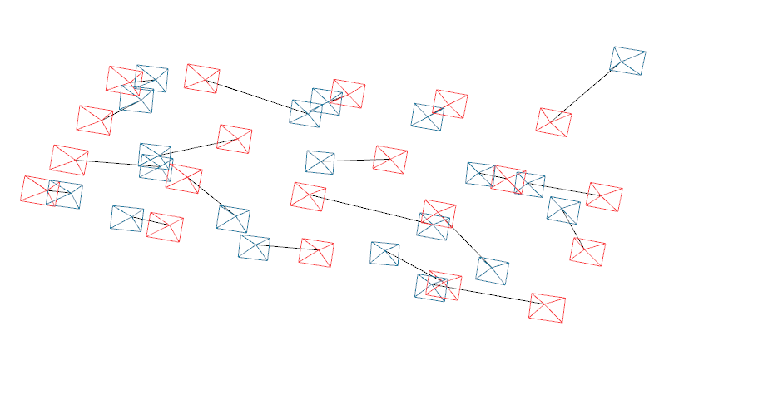
Result
Current training loss: 0.02, validate loss:0.07
The images shows the true position from Colmap(red) and the estimation of camera position(blue) based on one known pose matrix. As you can see, the estimation error of the pose matrix will accumulate as we continue to calculate the transformation matrix based on the previous estimated pose matrix.

Slide 17
Limitation and future works
The precision of the pose estimation largely depends on the precision of optic flow field, This error may accumulate and lead to the enlarged gap between true value and estimation value.
The estimation only works in a static scene, as the movement of object would also generate irregular optic flow field, which influence the optic flow field brought by the transformation of camera. Integrate the optic flow field with motion field may solve the problem.
Estimation for images with huge viewing shift may generate unreliable result, as old views may disappear and new views come in, which influences both optic flow field generation and translation estimation

Slide 18
Contribution
Chenfeng, Shan
Mainly responsible for research information collection and analysis,
focus on the construction of neural networks.
Xiangyu, Zeng
In charge of data collection and data preprocessing, also participate in
the construction of neural networks. Design the visualization of results.

Slide 19
Thank you

